Slide 1
Code Army
Vaccine Drive/Bus at your Service
Community Action Vaccine - CAV

Slide 2
Problem people facing
No vaccination site in his village, with the nearest hospital an hour away.
(prox to vacc site)

Slide 3
WHAT WE ARE WORKING ON
Making a SECURE Platform
ACCESSIBLE
FAST AND RELIABLE
We are working on the problem of not availability of vaccine to rural areas
Which dont have internet connectivity or the knowledge of booking appointment.
Despite Government is trying to solve this problem we are still facing lack of accessibility to vaccine.
We are working to make our service fast, easy and Reliable.

Slide 4
ABOUT THE PROJECT
The main objective of this project is to book appointment for the locality of small population and then send a vaccination bus/ drive to vaccinate people os the area at once.
This will lead to fast vaccination all over the country And people don’t have to come out of their homes during the Harsh time of this Pandemic (of Covid-19).

Slide 5
— Anonymous
“If you want to make a change Start at your hand & then ask others by showing your example”

Slide 6
NOW
Working on Dashboard
Can take huge traffic
Need to spread this its useability across coutry

Slide 7
FUTURE
Link with Govt website to implement in real time
Gaining trust and expand
Make it user friendly

Slide 8
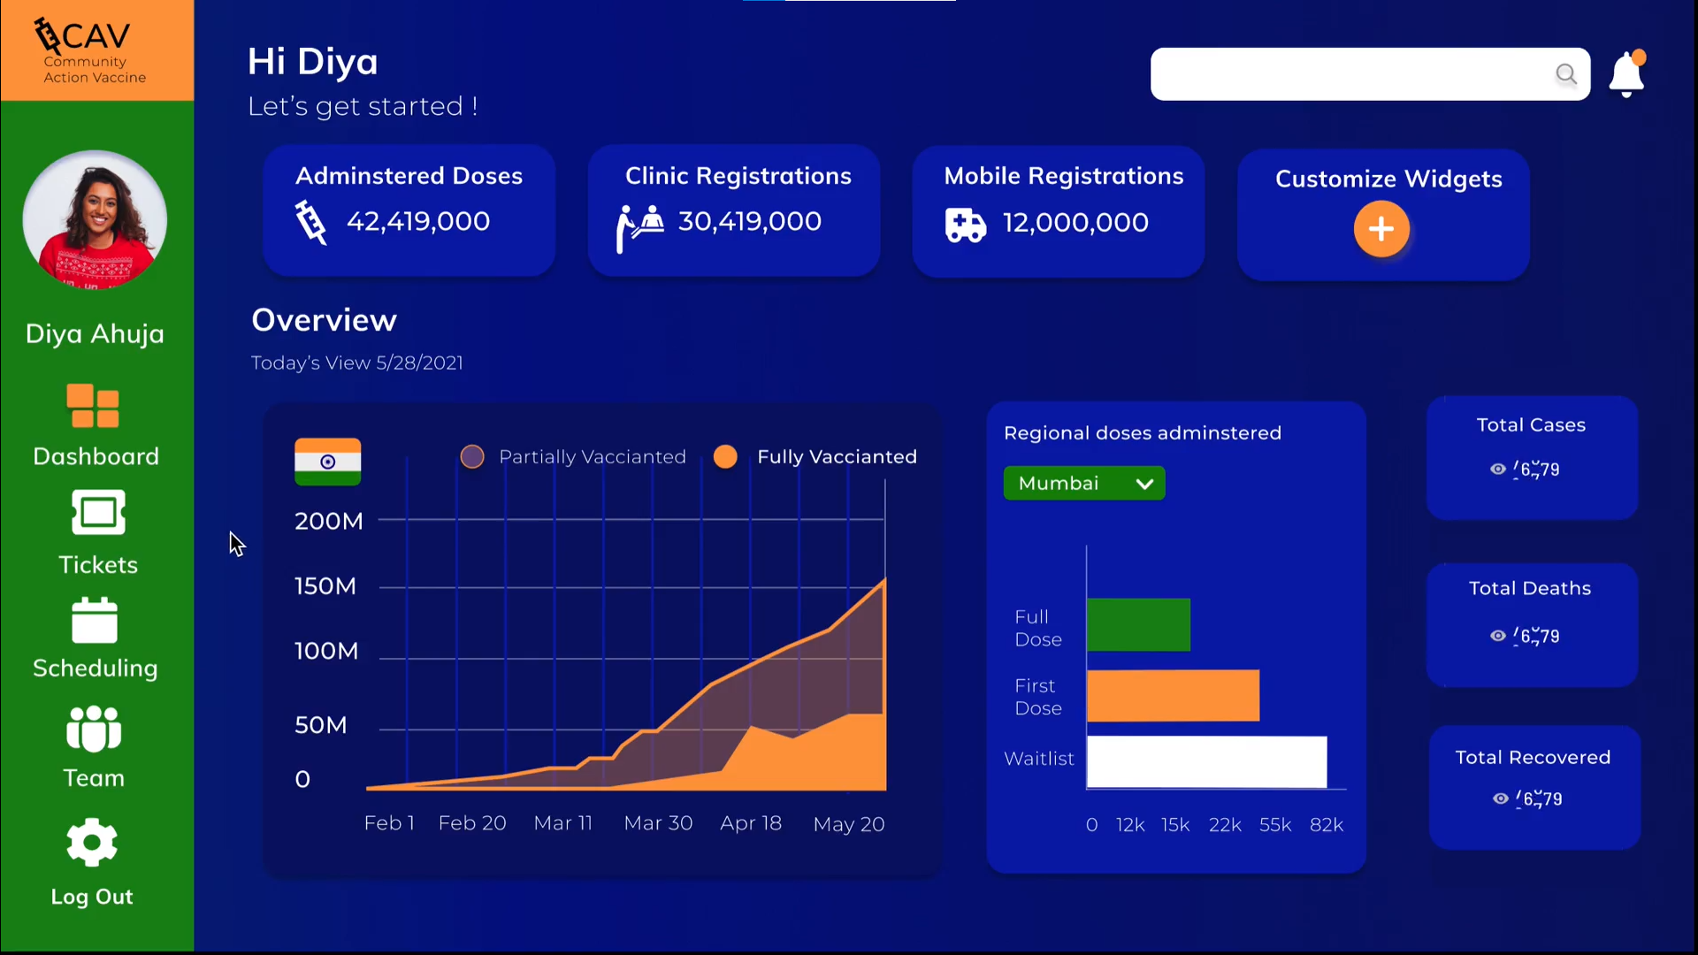
SNEAK PEEK

Slide 9
A VIDEO IS A GOOD IDEA
https://drive.google.com/file/d/1jYz39Os-dw8UHOUoIDA0453YCD484UQD/view

Slide 10
PROJECT STAGES
STEP 2
STEP 1
STEP 3
Which dont have internet connectivity or the knowledge of booking appointment even they can get help through this
We are working on the problem of not availability of vaccine to rural areas
Helping people to stay safe and healthy

Slide 11
THE TEAM - Code Army
Make the world fight against the pandemic (Covid-19)

Slide 12
Thank You!

